Slide 1

اصول طراحی پایگاه داده
By Dr. Taghinezhad
Mail:
a0taghinezhad@gmail.com
Notes:
Hello everyone,
I'm Dr. Taghinezhad, and I'm thrilled to be your guide through the exciting world of advanced databases this semester.
With a background in Computer Engineering and a focus on distributed systems, I've spent years diving into the intricacies of how data powers our digital world.
Throughout this course, we'll explore everything from the basics of data modeling to the complex database and distributed databases.
I believe in creating an environment where questions are encouraged, discussions are lively, and learning is a collaborative effort. So, I invite each of you to actively engage and share.
I want to introduce you to one of the major resources for this course: "Database System Concepts" by Abraham Silberschatz, Henry F. Korth, and S. Sudarshan.
This textbook is like our trusty map as we navigate the complex terrain of database systems. It's not just any map, though—it's a detailed, comprehensive guide that will help us understand the landscape, identify key landmarks, and chart our course to mastery.
If you are not going to attend in this calls. Please talk to before hand. Also select a representative among yourself.

Slide 2
Chapter 2: Intro to Relational Model

Slide 3
Outline
Structure of Relational Databases
Database Schema
Keys
Schema Diagrams
Relational Query Languages
The Relational Algebra
Notes:
1

Slide 4
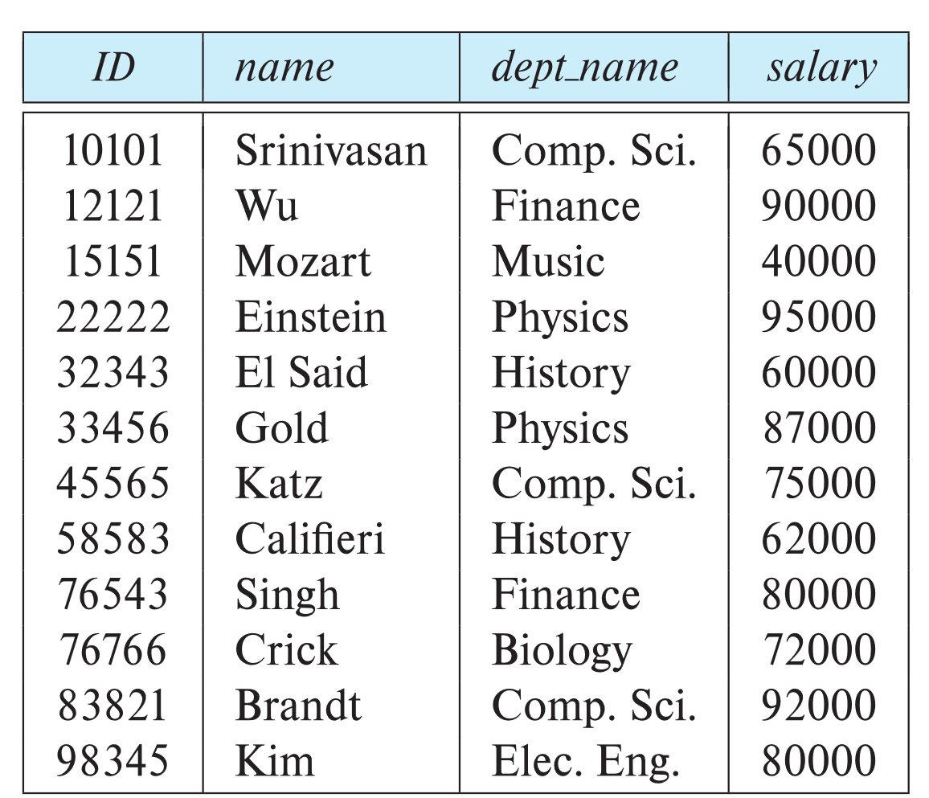
Example of a Instructor Relation
attributes
(or columns)
tuples
(or rows)

Slide 5
Relation Schema and Instance
A₁, A₂, …, A_{n} are attributes
R = (A₁, A₂, …, A_{n} ) is a relation schema
Example:
instructor = (ID, name, dept_name, salary)
A relation instance r defined over schema R is denoted by r (R).
The current values a relation are specified by a table
An element t of relation r is called a tuple and is represented by a row in a table
Notes:
1

Slide 6
Attributes
The set of allowed values for each attribute is called the domain of the attribute
Attribute values are (normally) required to be atomic; that is, indivisible
The special value null is a member of every domain. Indicated that the value is “unknown”
The null value causes complications in the definition of many operations

Slide 7
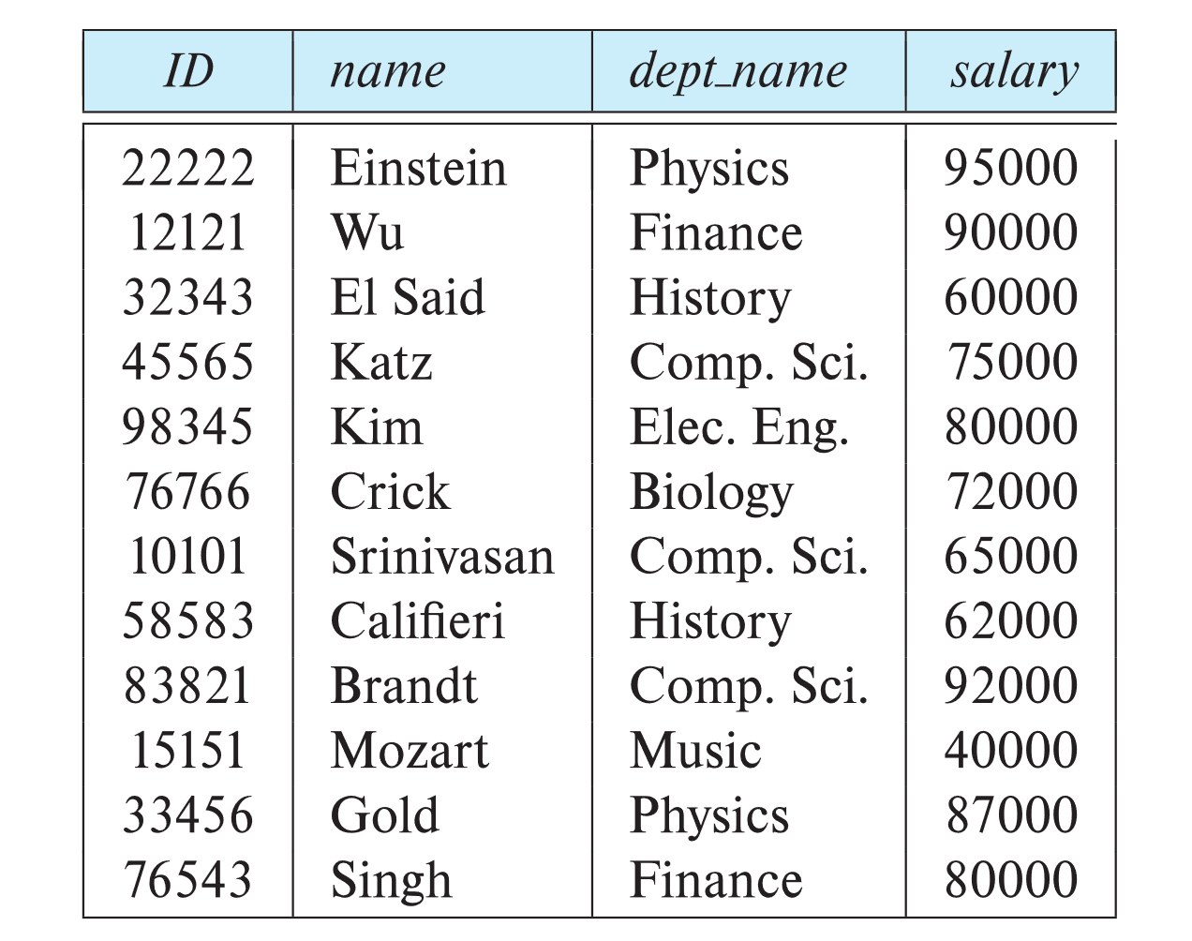
Relations are Unordered
Order of tuples is irrelevant (tuples may be stored in an arbitrary order)
Example: instructor relation with unordered tuples

Slide 8
Database Schema
Database schema -- is the logical structure of the database.
Database instance -- is a snapshot of the data in the database at a given instant in time.
Example:
  schema: instructor (ID, name, dept_name, salary)
  Instance:

Slide 9
Keys
Let K ⊆ R
K is a superkey of R, if values for K are sufficient to identify a unique tuple of each possible relation r(R)
  Example: {ID} and {ID,name} are both superkeys of instructor.
Superkey K is a candidate key if K is minimal
Example: {ID} is a candidate key for Instructor
One of the candidate keys is selected to be the primary key.
  Which one?
Foreign key constraint: Value in one relation must appear in another
  Referencing relation
  Referenced relation
  Example: dept_name in instructor is a foreign key from instructor referencing department
Notes:
A primary key is a candidate key chosen to uniquely identify tuples in a relation.Which candidate key is selected as the primary key?This decision is based on considerations such as simplicity, ease of use, and frequency of access.
A foreign key enforces a relationship between two relations.
A foreign key in one relation must correspond to a primary key in another relation .The relation with the foreign key is called the referencing relation, and the one with the primary key is called the referenced relation.

Slide 10
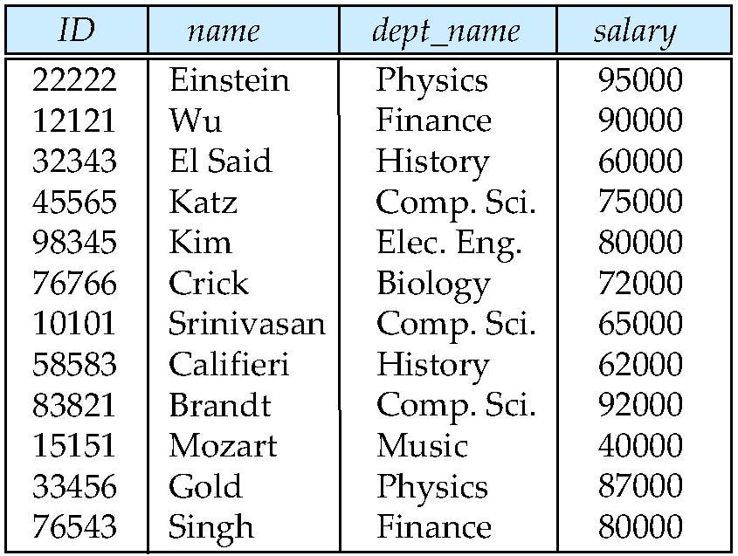
Keys
What are the Superkeys?
What are the Candidate Keys?

Slide 11
Example
S
P
City | Sname | S#
Tehran | Fanavaran | s1
Ardabil | Iran Segment | s2
Isfahan | Pooladin | s3
City | Type | Color | P#
Tehran | Iron | Red | P1
Ardabil | Copper | Green | P2
Isfahan | Brass | Blue | P3
Tehran | Iron | Red | P4
SP
Qty | P# | S#
300 | P1 | s1
200 | P2 | s2
400 | P3 | s3
300 | P1 | s2
400 | P2 | s2
200 | P2 | s3

Slide 12
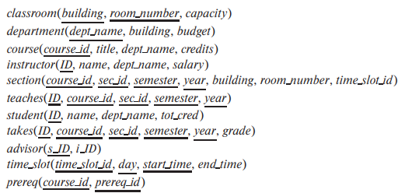
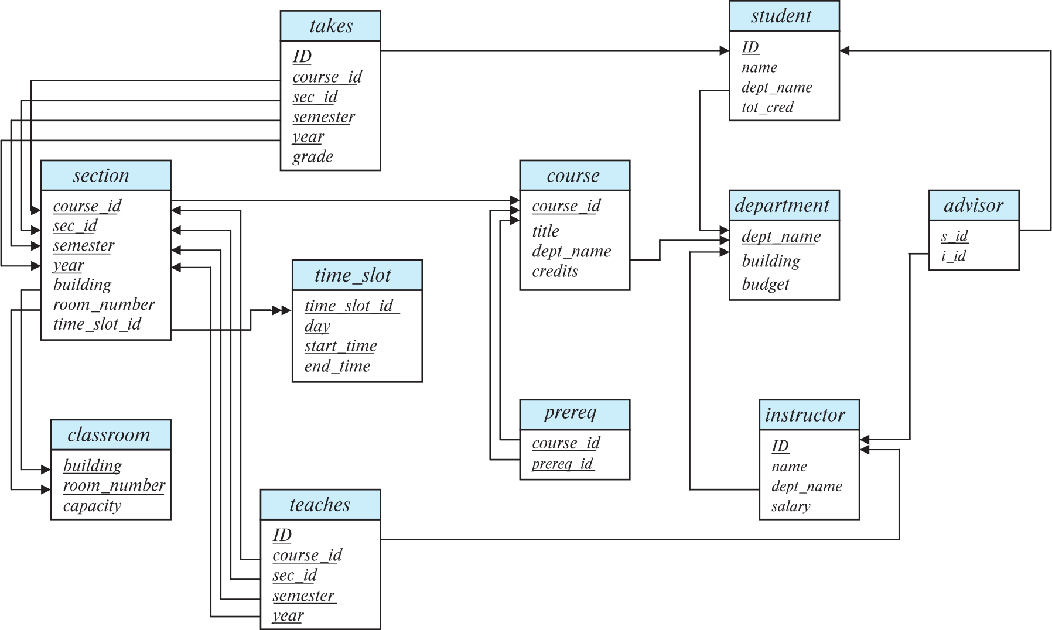
Schema Diagram for University Database

Slide 13
Relational Query Languages
Procedural versus non-procedural, or declarative
“Pure” languages:
  Relational algebra
  Tuple relational calculus
  Domain relational calculus
The above 3 pure languages are equivalent in computing power
We will concentrate in this chapter on relational algebra
  Not Turing-machine equivalent
  Consists of 6 basic operations

Slide 14
Relational Algebra
A procedural language consisting of a set of operations that take one or two relations as input and produce a new relation as their result.
Six basic operators
  select: σ
  project: ∏
  union: ∪
  set difference: –
  Cartesian product: x
  rename: ρ

Slide 15
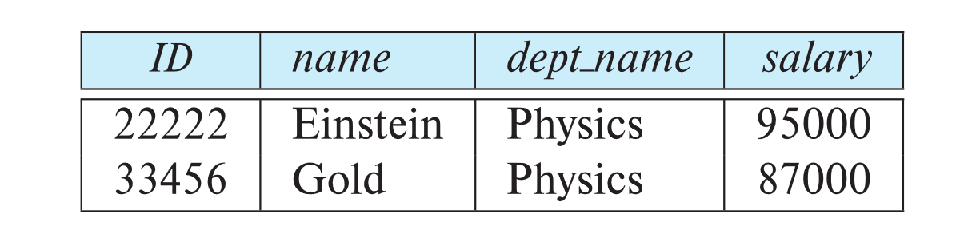
Select Operation
The select operation selects tuples that satisfy a given predicate.
Notation: σ _{p} (r)
p is called the selection predicate
Example: select those tuples of the instructor relation where the instructor is in the “Physics” department.
  Query
  σ _{dept_name=“Physics”} (instructor)
  Result

Slide 16
Select Operation (Cont.)
We allow comparisons using
=, ≠, >, ≥. <. ≤
in the selection predicate.
We can combine several predicates into a larger predicate by using the connectives:
∧ (and), ∨ (or), ¬ (not)
Example: Find the instructors in Physics with a salary greater $90,000, we write:
The select predicate may include comparisons between two attributes.
  Example, find all departments whose name is the same as their building name:
σ _{dept_name=“Physics”} ∧ _{salary >} _{90,000} (instructor)
  σ _{dept_name=building} (department)

Slide 17
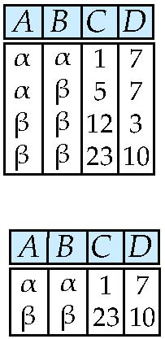
Select Operation – selection of rows (tuples)
Relation r: how to select A=B and D bigger than 5
σ_{A=B ^ D > 5} (r)
Select r where A=B and D>5

Slide 18
Project Operation
A unary operation that returns its argument relation, with certain attributes left out.
Notation:
∏ _{A1,A2,A3 ….Ak} (r)
where A₁, A₂, …, A_{k} are attribute names and r is a relation name.
The result is defined as the relation of k columns obtained by erasing the columns that are not listed
Duplicate rows removed from the result, since relations are sets

Slide 19
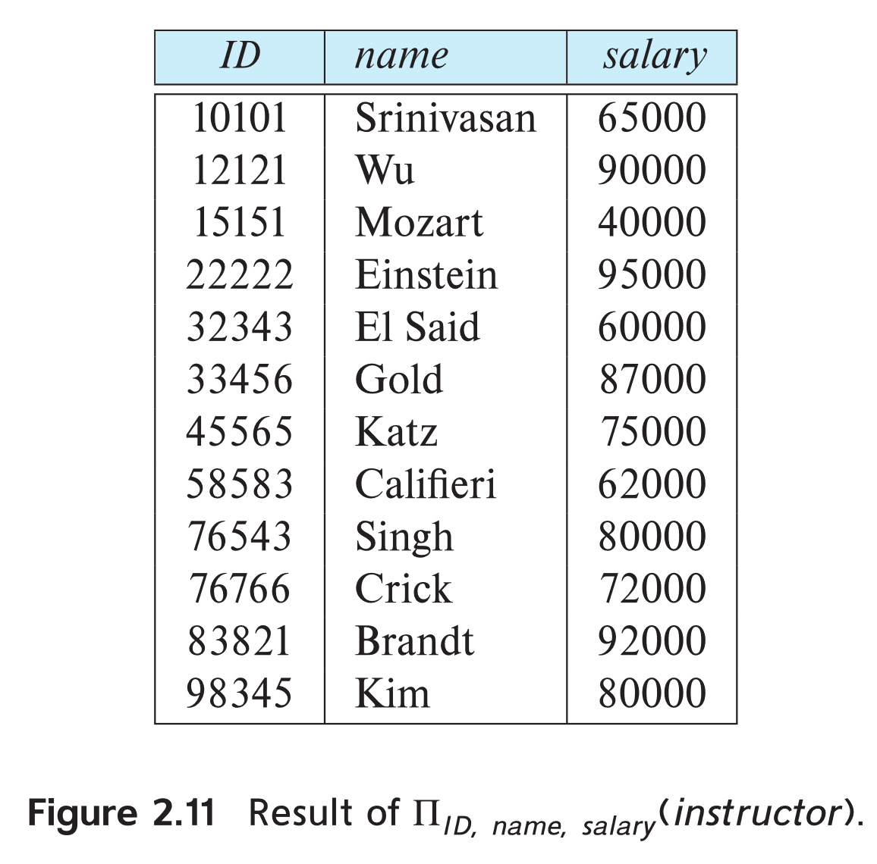
Project Operation Example
Example: eliminate the dept_name attribute of instructor
Query:
∏_{ID, name, salary} (instructor)
Result:

Slide 20
Composition of Relational Operations
The result of a relational-algebra operation is relation and therefore of relational-algebra operations can be composed together into a relational-algebra expression.
Consider the query -- Find the names of all instructors in the Physics department.
Instead of giving the name of a relation as the argument of the projection operation, we give an expression that evaluates to a relation.
∏_{name}(σ _{dept_name} _{=“Physics”} (instructor))

Slide 21
Cartesian-Product Operation
The Cartesian-product operation (denoted by X) allows us to combine information from any two relations.
Example: the Cartesian product of the relations instructor and teaches is written as:
instructor X teaches
We construct a tuple of the result out of each possible pair of tuples: one from the instructor relation and one from the teaches relation (see next slide)
Since the instructor ID appears in both relations we distinguish between these attribute by attaching to the attribute the name of the relation from which the attribute originally came.
  instructor.ID
  teaches.ID

Slide 22
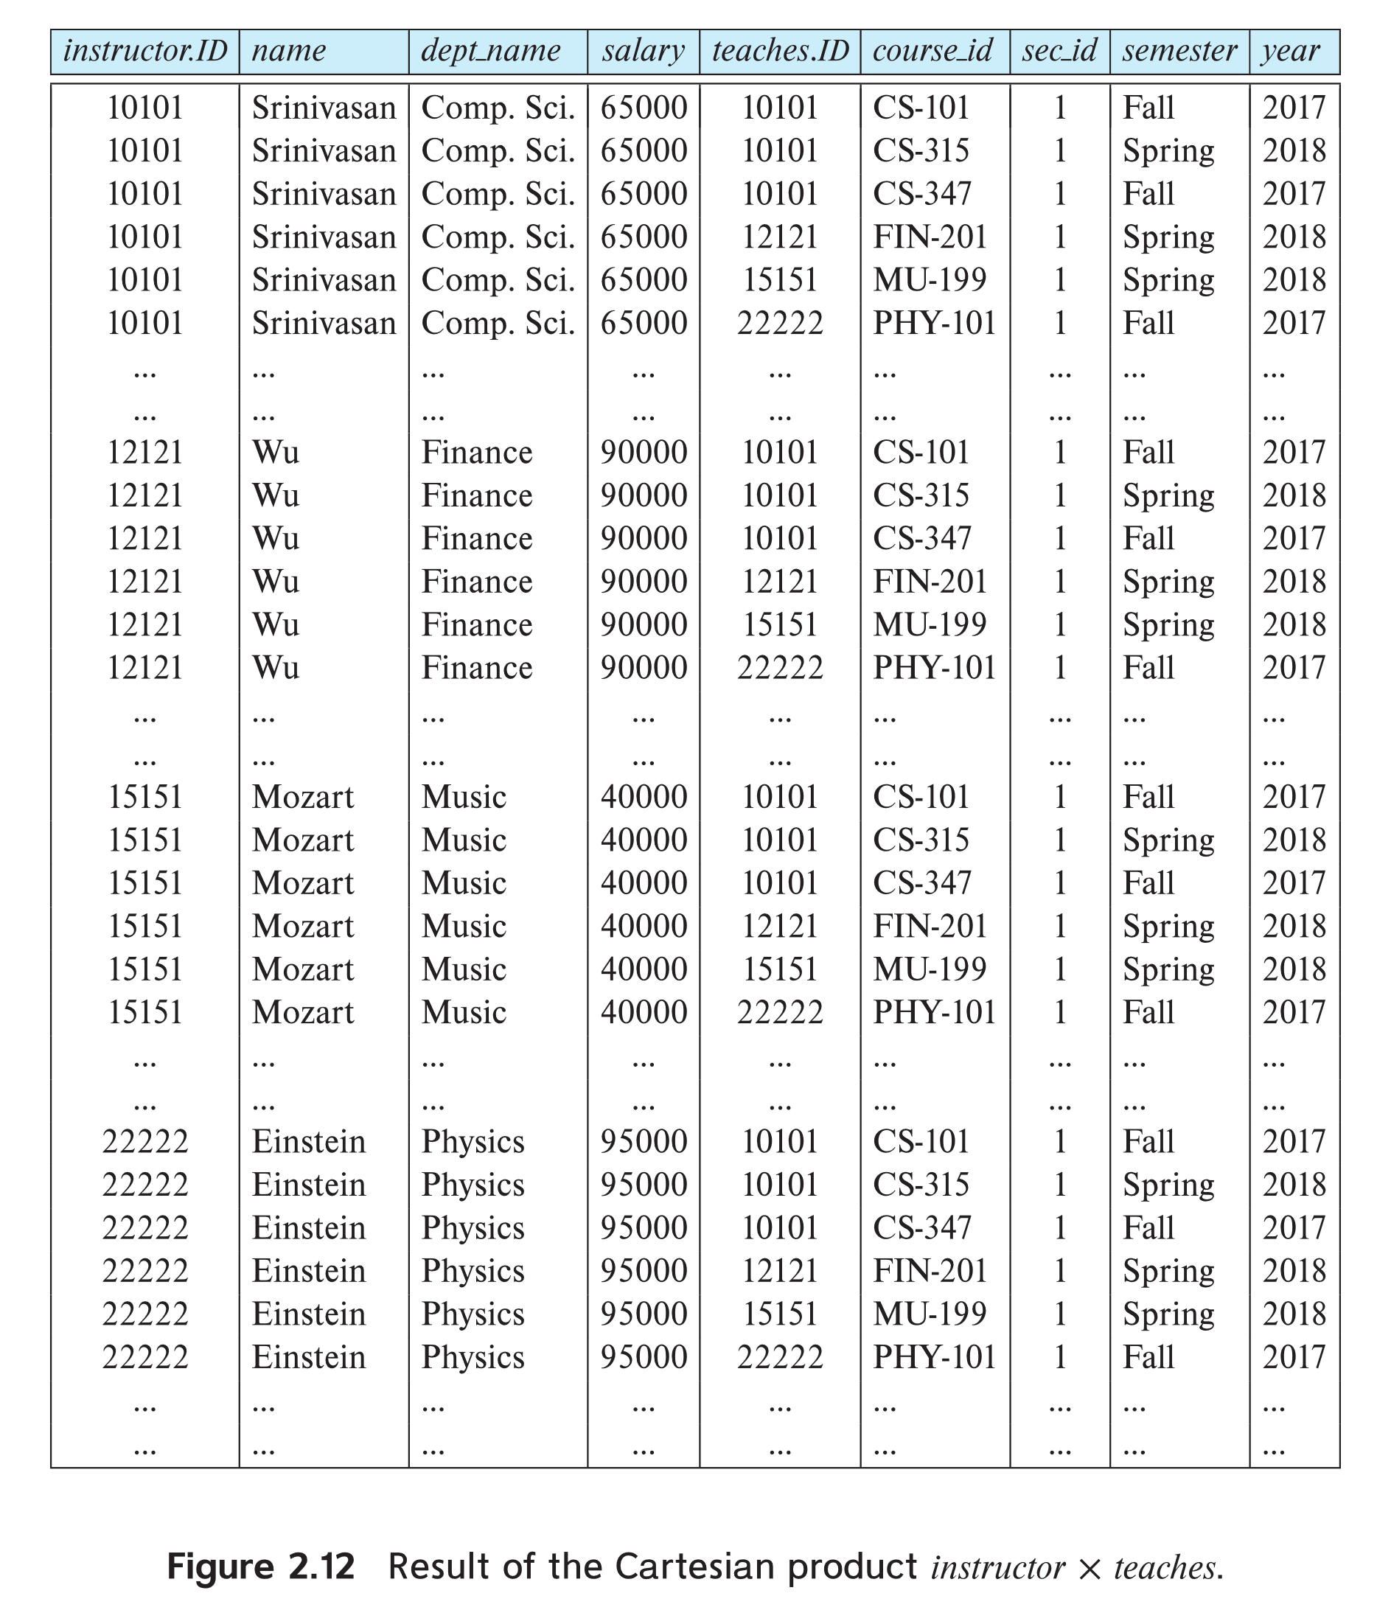
The instructor X teaches table

Slide 23
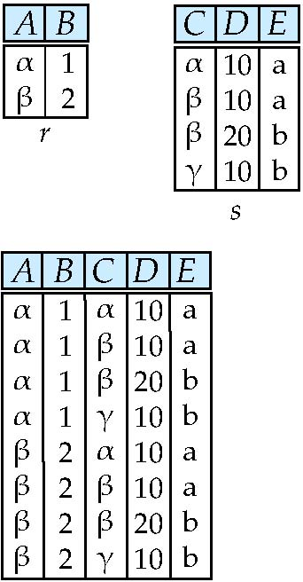
joining two relations -- Cartesian-product
Relations r, s:
r x s:

Slide 24
Cartesian-product – naming issue
B
Relations r, s:
r.B
s.B
r x s:

Slide 25
Join Operation
The Cartesian-Product
instructor X teaches
associates every tuple of instructors with every tuple of teaches.
  Most of the resulting rows have information about instructors who did NOT teach a particular course.
To get only those tuples of “instructor X teaches “ that pertain to instructors and the courses that they taught, we write:
  We get only those tuples of “instructor X teaches” that pertain to instructors and the courses that they taught.
The result of this expression, shown in the next slide
σ _{instructor.id = teaches.id} (instructor x teaches ))

Slide 26
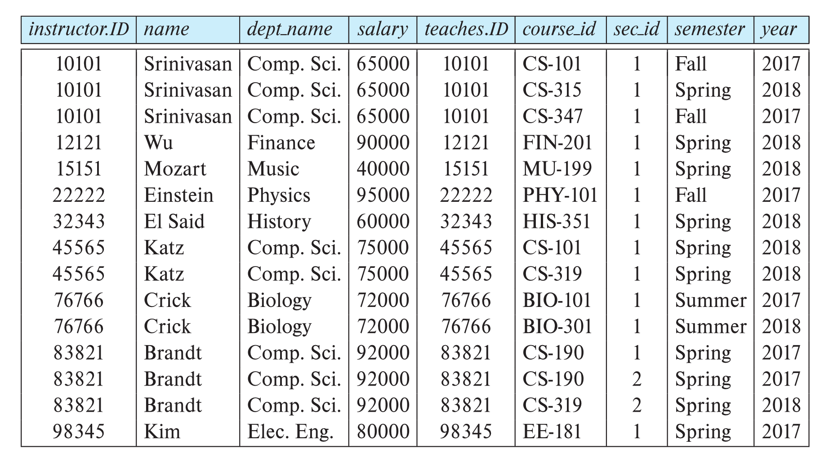
Join Operation (Cont.)
The table corresponding to:
σ _{instructor.id = teaches.id} (instructor x teaches))

Slide 27
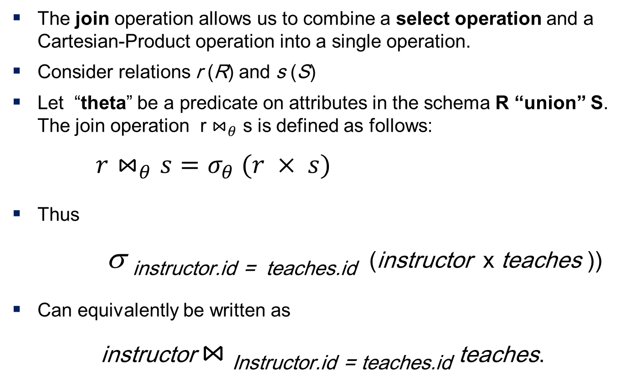
Join Operation (Cont.)
The join operation allows us to combine a select operation and a Cartesian-Product operation into a single operation.
Consider relations r (R) and s (S)
Let “theta” be a predicate on attributes in the schema R “union” S. The join operation r $⋈_{θ}$ s is defined as follows:
$r⋈_{θ}s=σ_{θ} (r × s)$
Thus
σ _{instructor.id = teaches.id} (instructor x teaches ))
Can equivalently be written as
instructor $⋈_{ }$_{Instructor.id = teaches.id} teaches.

Slide 28
Union Operation
The union operation allows us to combine two relations
Notation: r ∪ s
For r ∪ s to be valid.
1. r, s must have the same arity (same number of attributes)
2. The attribute domains must be compatible (example: 2nd
  column of r deals with the same type of values as does the
  2nd column of s)

Slide 29
Union Operation
Example: to find all courses taught in the Fall 2017 semester, or in the Spring 2018 semester, or in both
∏_{course_id} (σ _{semester=“Fall” Λ year=2017} (section)) ∪ ∏_{course_id} (σ _{semester=“Spring” Λ year=2018} (section))

Slide 30
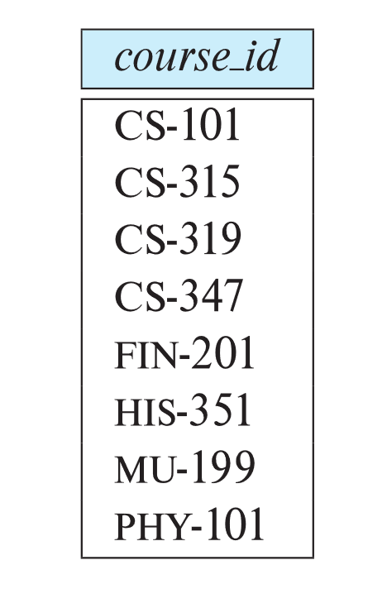
Union Operation (Cont.)
Result of:
∏_{course_id} (σ _{semester=“Fall” Λ year=2017} (section)) ∪
∏_{course_id} (σ _{semester=“Spring” Λ year=2018} (section))

Slide 31
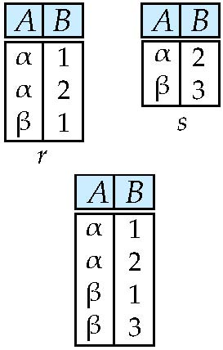
Union of two relations
Relations r, s:
اجتماع دو رابطه رابطه ای است که تاپلهایش در یک یا هر دو رابطه وجود دارند. یعنی رکوردهایی 2 جدول با هم ترکیب شده و رکوردهای تکراری یکبار نوشته می شوند.
r ∪ s:
r union s

Slide 32
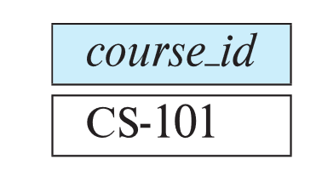
Set-Intersection Operation
The set-intersection operation allows us to find tuples that are in both the input relations.
Notation: r ∩ s
Assume:
  r, s have the same arity
  attributes of r and s are compatible
Example: Find the set of all courses taught in both the Fall 2017 and the Spring 2018 semesters.
∏_{course_id} (σ _{semester=“Fall” Λ year=2017} (section)) ∩
∏_{course_id} (σ _{semester=“Spring” Λ year=2018} (section))
  Result

Slide 33
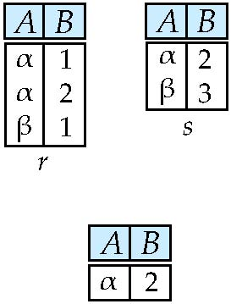
Set intersection of two relations
Relation r, s:
r ∩ s
r intersect s
Note: r ∩ s = r – (r – s)
Notes:
روابط ورودی برای عملگرهای اجتماع اشتراک و تفاضل باید همتا باشند یعنی تعداد صفتهای دو رابطه مساوی و صفتها به ترتیب دارای دامنه یکسان باشند.

Slide 34

Set Difference Operation
The set-difference operation allows us to find tuples that are in one relation but are not in another.
Notation r – s
Set differences must be taken between compatible relations.
  r and s must have the same arity
  attribute domains of r and s must be compatible
Example: to find all courses taught in the Fall 2017 semester, but not in the Spring 2018 semester
∏_{course_id} (σ _{semester=“Fall” Λ year=2017} (section)) −
∏_{course_id} (σ _{semester=“Spring” Λ year=2018} (section))

Slide 35
The Assignment Operation
It is convenient at times to write a relational-algebra expression by assigning parts of it to temporary relation variables.
The assignment operation is denoted by ← and works like assignment in a programming language.
Example: Find all instructor in the “Physics” and Music department.
Physics ← σ _{dept_name=“Physics”} (instructor)
  Music ← σ _{dept_name=“Music”} (instructor)
  Physics ∪ Music
With the assignment operation, a query can be written as a sequential program consisting of a series of assignments followed by an expression whose value is displayed as the result of the query.

Slide 36
The Rename Operation
The results of relational-algebra expressions do not have a name that we can use to refer to them. The rename operator, ρ , is provided for that purpose
The expression:
ρ_{x} (E)
returns the result of expression E under the name x
Another form of the rename operation:
ρ_{x(A1,A2, .. An)} (E)
Notes:
Rho: P

Slide 37
Equivalent Queries
There is more than one way to write a query in relational algebra.
Example: Find information about courses taught by instructors in the Physics department with salary greater than 90,000
Query 1
σ _{dept_name=“Physics”} ∧ _{salary > 90,000} (instructor)
Query 2
σ _{dept_name=“Physics”} (σ _{salary > 90.000} (instructor))
The two queries are not identical; they are, however, equivalent -- they give the same result on any database.

Slide 38
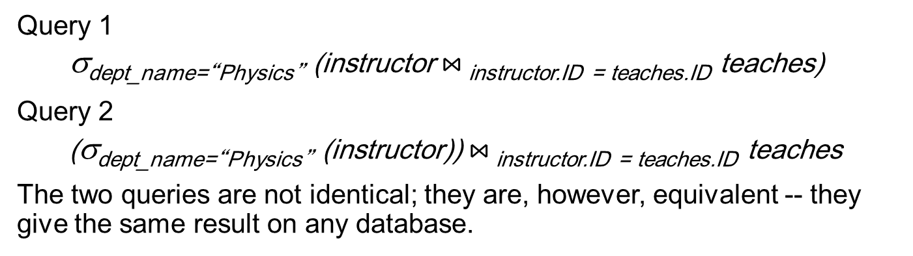
Equivalent Queries
There is more than one way to write a query in relational algebra.
Example: Find information about courses taught by instructors in the Physics department
Query 1
σ_{dept_name=“Physics”} (instructor $⋈_{ }$_{instructor.ID = teaches.ID} teaches)
Query 2
(σ_{dept_name=“Physics”} (instructor)) $⋈_{ }$_{instructor.ID = teaches.ID} teaches
The two queries are not identical; they are, however, equivalent -- they give the same result on any database.

Slide 39
Example
اسامی تهیه کنندگان قطعه P2
Name of P2 producers
S
P
SP
City | Sname | S#
Tehran | Fanavaran | s1
Tabriz | Iran Segment | s2
Tabriz | Pooladin | s3
City | Type | Color | P#
Tehran | Iron | Red | P1
Tabriz | Copper | Green | P2
Shiraz | Brass | Blue | P3
Tehran | Iron | Red | P4
Qty | P# | S#
300 | P1 | s1
200 | P2 | s2
400 | P3 | s3
300 | P1 | s2
400 | P2 | s2
200 | P2 | s3

Slide 40
Example
اسامی تهیه کنندگان قطعه P2 را تهیه میکنند
Name of P2 producers
∏_{Sname} (σ_{P#=P2} (S∞SP))
S join SP giving Temp1
Select Temp1 where P# = ‘P2’ Giving Temp2
Project Temp2 [Sname]
S
P
SP
City | Sname | S#
Tehran | Fanavaran | s1
Tabriz | Iran Segment | s2
Tabriz | Pooladin | s3
City | Type | Color | P#
Tehran | Iron | Red | P1
Tabriz | Copper | Green | P2
Shiraz | Brass | Blue | P3
Tehran | Iron | Red | P4
Qty | P# | S#
300 | P1 | s1
200 | P2 | s2
400 | P3 | s3
300 | P1 | s2
400 | P2 | s2
200 | P2 | s3

Slide 41
Example
اسامی تهیه کنندگان را که حداقل یک قطعه قرمز رنگ تهیه می کنند
S
P
SP
City | Sname | S#
Tehran | Fanavaran | s1
Tabriz | Iran Segment | s2
Tabriz | Pooladin | s3
City | Type | Color | P#
Tehran | Iron | Red | P1
Tabriz | Copper | Green | P2
Shiraz | Brass | Blue | P3
Tehran | Iron | Red | P4
Qty | P# | S#
300 | P1 | s1
200 | P2 | s2
400 | P3 | s3
300 | P1 | s2
400 | P2 | s2
200 | P2 | s3

Slide 42
Example
اسامی تهیه کنندگان را که حداقل یک قطعه قرمز رنگ تهیه می کنند
Temp1← σ_{Color=‘Red’} (P))
Temp2 ← ∏_{p#} (Temp1)
Temp3 ←(temp2 ∞ SP )
Temp4← ∏_{s#} (Temp3)
Temp5← ∏_{s#} (Temp4∞S)
Temp6← ∏_{sname} (Temp5)
Select P where color=‘Red’ Giving Temp1
Project Temp1 [P#] Giving Temp2
Temp2 Join SP Giving Temp3
Project Temp3 [S#] Giving Temp4
Temp4 Join S Giving Temp5
Project Temp5 [Sname] Giving Temp6
S
P
SP
City | Sname | S#
Tehran | Fanavaran | s1
Tabriz | Iran Segment | s2
Tabriz | Pooladin | s3
City | Type | Color | P#
Tehran | Iron | Red | P1
Tabriz | Copper | Green | P2
Shiraz | Brass | Blue | P3
Tehran | Iron | Red | P4
Qty | P# | S#
300 | P1 | s1
200 | P2 | s2
400 | P3 | s3
300 | P1 | s2
400 | P2 | s2
200 | P2 | s3

Slide 43
Example
اسامی تهیه کنندگانی را بیابید که قطعه P2 را تهیه نمی کنند
S
P
SP
City | Sname | S#
Tehran | Fanavaran | s1
Tabriz | Iran Segment | s2
Tabriz | Pooladin | s3
City | Type | Color | P#
Tehran | Iron | Red | P1
Tabriz | Copper | Green | P2
Shiraz | Brass | Blue | P3
Tehran | Iron | Red | P4
Qty | P# | S#
300 | P1 | s1
200 | P2 | s2
400 | P3 | s3
300 | P1 | s2
400 | P2 | s2
200 | P2 | s3

Slide 44
Example
اسامی تهیه کنندگانی را بیابید که قطعه P2 را تهیه نمی کنند
∏_{Sname} [[∏_{s#} (S)- (∏_{s#} (σ_{P#=‘P2’} (SP)) )] ∞S]
S
P
SP
City | Sname | S#
Tehran | Fanavaran | s1
Tabriz | Iran Segment | s2
Tabriz | Pooladin | s3
City | Type | Color | P#
Tehran | Iron | Red | P1
Tabriz | Copper | Green | P2
Shiraz | Brass | Blue | P3
Tehran | Iron | Red | P4
Qty | P# | S#
300 | P1 | s1
200 | P2 | s2
400 | P3 | s3
300 | P1 | s2
400 | P2 | s2
200 | P2 | s3

Slide 45
پیوند شرطی
عملگر پیوند شرطی (ɵ-join)
این عملگر، زیر مجموعه ای از ضرب دکارتی است که شرط ɵ روی سطرهای آن اعمال شده باشد. ستونهای خروجی معادل ستونهای ضرب دکارتی است.
Xɵ
مثال خروجی دستور زیر
S Xs.city>=P.city P
City | Type | Color | P# | City | Sname | S#
Tehran | Iron | Red | P1 | Tehran | Fanavaran | s1
Tabriz | Copper | Green | P2 | Tehran | Fanavaran | s1
Tehran | Iron | Red | P4 | Tehran | Fanavaran | s1
Tabriz | Copper | Green | P2 | Tabriz | Iran Segment | s2
Tabriz | Brass | Blue | P3 | Tabriz | Pooladin | s3

Slide 46
Natural Join
A | B
X | Y
X | Z
Y | Z
Z | V
B | C
Z | U
V | W
Z | V
R= S=
R |×| S=
A | B | C
X | Z | U
X | Z | V
Y | Z | U
Y | Z | V
Z | V | W

Slide 47
Semi-join
مشابه پیوند طبیعی است با این تفاوت که فقط ستونهای جدول اول را می دهد.
S
P
SP
City | Sname | S#
Tehran | Fanavaran | s1
Tabriz | Iran Segment | s2
Tabriz | Pooladin | s3
City | Type | Color | P#
Tehran | Iron | Red | P1
Tabriz | Copper | Green | P2
Shiraz | Brass | Blue | P3
Tehran | Iron | Red | P4
Qty | P# | S#
300 | P1 | s1
200 | P2 | s2
400 | P3 | s3
300 | P1 | s2
400 | P2 | s2
200 | P2 | s3

Slide 48
Outer Join
1- فراپیوند چپ : Left Outer Join L-O-JOIN
2- فراپیوند راست :Right Outer Join
3- فراپیوند کامل Full Outer Join
فراپیوند چپ گونه ای از عملگر پیوند طبیعی است با این تفاوت که علاوه بر تاپلهای پیوند شدنی از دو رابطه، تاپلهای نشدنی از رابطه چپ هم ، پیوند شده با مقادیر NULL، در جواب وارد می شود در فراپیوند راست، تاپلهای پیوند نشدنی از رابطه سمت راستی ، پیوند شده با مقادیر NULL وارد می شوند.
مثال:
S L-O-JOIN SP
S
SP
Status | Sname | S#
10 | Sn1 | s1
15 | Sn2 | s2
10 | Sn3 | S3
20 | Sn4 | S4
Qty | P# | S#
200 | P1 | S1
400 | P3 | S2
100 | P4 | S2
300 | P1 | S3

Slide 49
Outer Join
مثال:
S L-O-JOIN SP
Qty | P# | Status | Sname | S#
200 | P1 | 10 | Sn1 | s1
400 | P3 | 15 | Sn2 | s2
100 | P4 | 15 | Sn2 | s2
300 | P1 | 10 | Sn3 | S3
NULL | NULL | 20 | Sn4 | S4
S
SP
Status | Sname | S#
10 | Sn1 | s1
15 | Sn2 | s2
10 | Sn3 | S3
20 | Sn4 | S4
Qty | P# | S#
200 | P1 | S1
400 | P3 | S2
100 | P4 | S2
300 | P1 | S3

Slide 50
Summary of Relational Algebra Operators
Symbol (Name) Example of Use
σ
(Selection) ^{σ} salary > = 85000 ^{(instructor)}
Return rows of the input relation that satisfy the predicate.
Π
(Projection) ^{Π} ID, salary ^{(instructor)}
Output specified attributes from all rows of the input relation. Remove duplicate tuples from the output.
x
(Cartesian Product) instructor x department
Output pairs of rows from the two input relations that have the same value on all attributes that have the same name.
∪
(Union) ^{Π} name ^{(instructor) ∪ Π} name ^{(student)}
Output the union of tuples from the two input relations.
-
(Set Difference) ^{Π} name ^{(instructor)} ^{-- Π} name ^{(student)}
Output the set difference of tuples from the two input relations.
⋈
(Natural Join) instructor ⋈ department
Output pairs of rows from the two input relations that have the same value on all attributes that have the same name.

Slide 51
Divide operator
Suppose we have this extra table, in the Bank database
Suppose we would like to know which customers have alltypes of accounts.

Slide 52
Divide Operation

Slide 53
Divide Definition
For R + S where R (r1, r2, r3, r4) and S(s1, s2)
Since S has two attributes, there must be two attributes in R (say r3 and r4) defined on the same domains, respectively, as s1 and s2. We could say that(r3, r4) is union-compatible with (s1, s2).
The query answer has the remaining attributes (r1, r2).
And the answer has a tuple, (r1, r2), in the answer if the(r1, r2) value appears with every S tuple in R.
Notes:
برای R+SR + SR+S که در آن R(r1,r2,r3,r4)R(r_1, r_2, r_3, r_4)R(r1​,r2​,r3​,r4​) و S(s1,s2)S(s_1, s_2)S(s1​,s2​) هستند:
از آنجا که SSS دو ویژگی دارد، باید دو ویژگی در RRR (فرضاً r3r_3r3​ و r4r_4r4​) روی دامنه‌های مشابه با s1s_1s1​ و s2s_2s2​ تعریف شده باشند. می‌توان گفت که (r3,r4)(r_3, r_4)(r3​,r4​) با (s1,s2)(s_1, s_2)(s1​,s2​) از نظر اجتماع‌پذیری سازگار است.
پاسخ پرس‌وجو شامل ویژگی‌های باقی‌مانده (r1,r2)(r_1, r_2)(r1​,r2​) خواهد بود.
و در صورتی که مقدار (r1,r2)(r_1, r_2)(r1​,r2​) با هر تاپل SSS در RRR ظاهر شود، تاپل (r1,r2)(r_1, r_2)(r1​,r2​) در پاسخ وجود خواهد داشت.

Slide 54

When to divide?
Not supported as a primitive operator, but useful for expressing queries like:
  Find customers who have all types of accounts.
Let A have 2 fields, x , y, B have only field y.
  A/B= {$\left(x\right)| ∃\left(x,y\right)∈A ∀\left(y\right)∈B$}
  i.e., A/B contains all x tuples (customers) such that for every y tuple (account type) in B, there is an xy tuple in A.
  Or. If the set of y values (account types) associated with an x value(customer) in A contains all y values in B, the x value is in A/B.
In general, x and y can be any lists of fields; y is the list of fields in B, and x U y is the list of fields of A.- A/B =

Slide 55
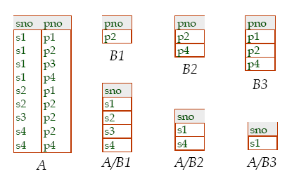
Division Example

Slide 56
End of Chapter 2

